Slide 1

Ames, Iowa Housing Data Analysis
By: Daniel Immediato
Date: 5/03/24
Notes:
The third project was designated based on Kaggle’s Competition on the Ames, Iowa dataset. The focus of the project was to creative descriptive insights, predictions based on said dataset, and create machine learning models.

Slide 2
Preliminary: What is the Ames Dataset?
Ames, Iowa is a college town of Iowa State University. The Ames dataset consists of the housing sale records between 2006-2010, including features like their attributes and sale prices. The goal of this project was twofold:
Provide a data analysis of the included features.
This includes descriptive models of key features (such as linear and lasso regressions). The highlight being to find the strongest correlations and those values with highest statistical significance.
Develop machine learning algorithms for the sale prices.
This includes multiple linear regression, random forest, and time series. The focus would be on high accuracy and high variance (R Squared).
Ideally, one would find the most significant contributing factors using multiple linear regression, then one would find the most important indicators using random forest.
Notes:
The Ames dataset itself covers numerous variables focusing on a college town in Iowa, from 2006-2010. Basically, the goal was to mold the data into a workable state, create machine learning algorithms based on that data, refine the algorithms as needed, and then provide an analysis of the results. The target of the project as a whole was sale price, where we wanted to see which factors influenced sale price the most, both in regards to feature importance (which can be done through a random forest model) and correlation strength (which can be done through a multiple linear regression model).

Slide 3
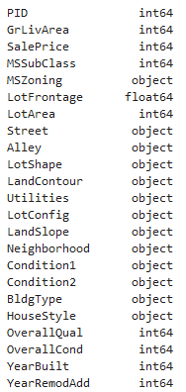
Modifying the Data: Data Types
Before beginning any sort of analysis, one must examine whether or not the data “can” be anyalyzed properly to begin with. The typical dataset is split between numeric and categorical values. When coding, one has to ensure values are consistently classified throughout.
As a few examples, taken plainly, YearBuilt and YearRemodAdd are both dates and not integers. We also know PID (a classification) is a string, not an integer. MSSubClass is also a category, not an integer.
It is necessary to convert these to their proper data types, otherwise errors may occur or results may appear different than expected.
Notes:
The Ames dataset, like most datasets, has multiple data types, with the majority being divided between categorical (string and objects) and numeric (integer and float). When dealing with so many variables, it’s advised to properly assigned the data types, otherwise preforming an analysis might not even work to begin with. As an example here, we know MSSubClass is a category, not an integer. This is important for labelencoding. I opted to convert the files to pkles for easier transfer from python file to python, which preserves data type integrity.

Slide 4
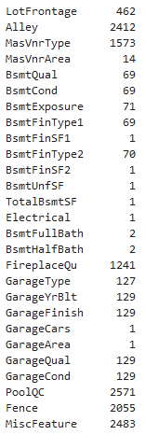
Modifying the Data: Nulls and NA
An NA value is likely to cause the most issues when dealing with data. When running functions, depending on the program, many can’t process them and may produce an error or show results incorrectly. To deal with them you have several options, such as:
Assume what the value was going to be based on related values.
Replace values as a “0” or “none” if the value is legitimately lacking, or if there is no value.
Replace values with most common value or median.
Shown is an untransformed version of the “count” of all missing values in the dataset.
Notes:
Another preliminary to take into note is the amount of NA and Null values in your data. These can also lead to errors if they remain. One can drop rows containing them entirely, replace them with “none” or “0”, or replace them with the mean, median, or most likely value.

Slide 5
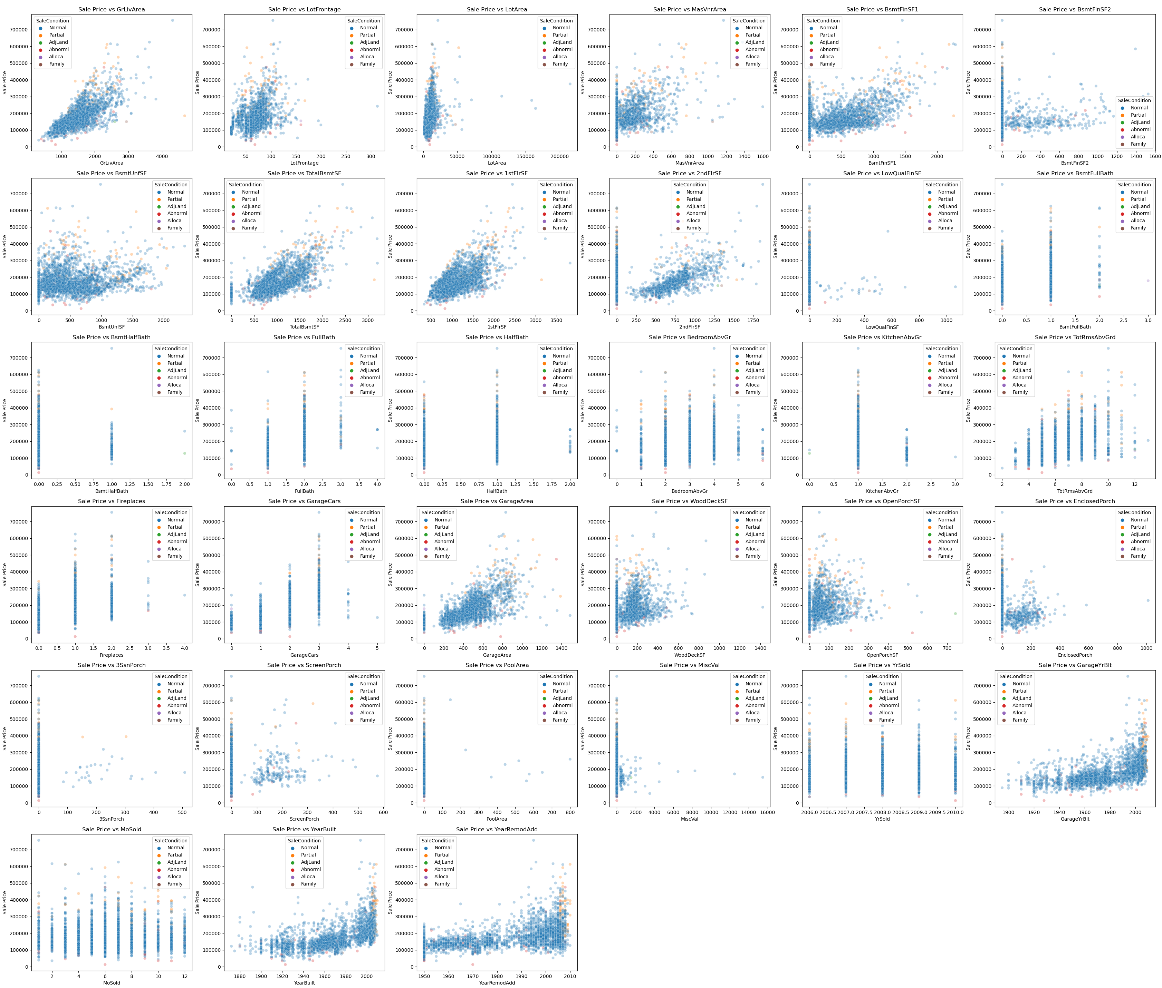
Overview: Numeric
Here is every numeric variable tested against the target, which is SalePrice. We can see many of the variables have some sort of correlation just from eyeing them, and we can also tell which might satisfy the features of linear regression.
We can also see which variables are ordinal judging by the spacing of the plot points.
However, having so much data displayed like this is not very helpful.
Notes:
Here we see a summary of the numeric features plotted against the target. As an overview, many of them seem to have a basic positive trend (just for example the first one top left, above ground living area, appears to coincide with linearity). Noticeable are also the variables that are ordinal, where several still maintain that positive trend, such as size of garage in car capacity (2nd column, 3rd row).

Slide 6
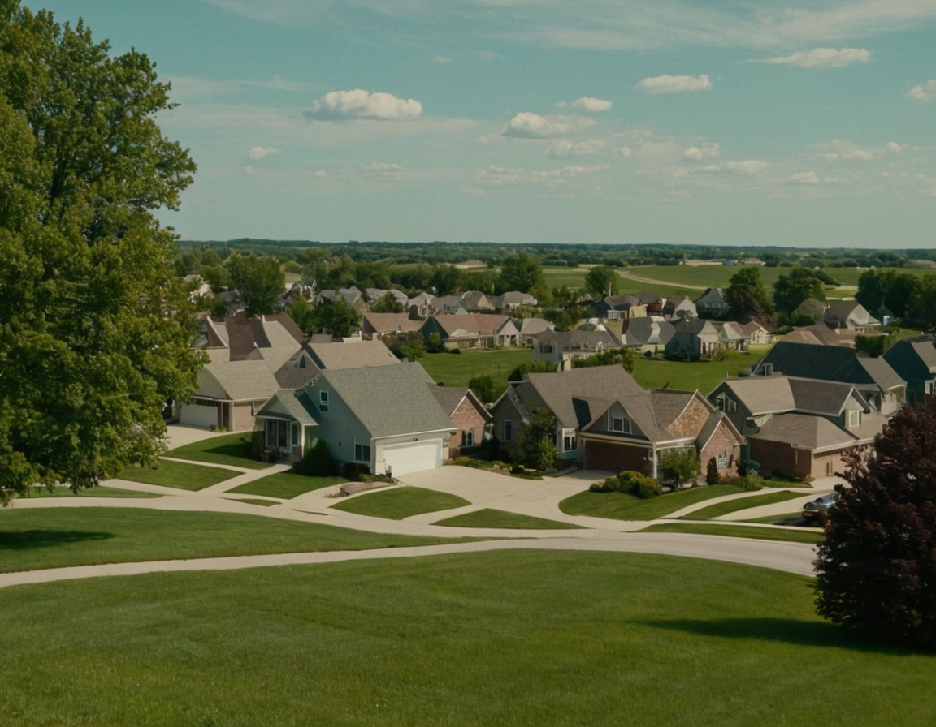
Multiple Linear Regression: As a Model
A MLR is used to determine the strength of relationships, as well as statistical significance. This type of model can help us find the more important variables when compared to our target.
One must ensure features are linear to the target, there is constant variance, normality of errors, there is independence of errors, and that there is as little multi-collinearity as possible.
(Image Created Via Stable Diffusion)
Notes:
The previous overview showed what a MLR could analyze. As a model, regressions determine the strength of relationships between variables, as well as the statistical significance. MLR is unique in that it can be subject to multi-collinearity, where the more and more features that are added, the increasing likelihood that said features are going to influence each other and the outcome.

Slide 7
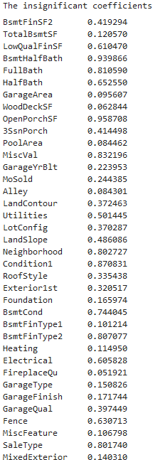
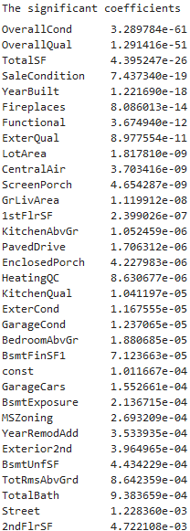
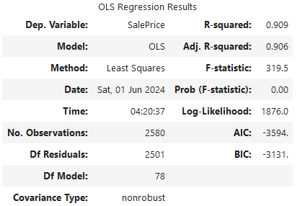
MLR: Unrefined
Since there wasn’t a starting point, we ran a model on all columns (with some modifications). Ironically, the score was surprisingly high at .91. However, this is unlikely to be helpful considering how much this model suffers from multi-collinearity.
Still, this gives us a basis on where to refine the data based on the significant coefficients.
Notes:
With SalePrice being used as the target, a MLR model created, generally untouched (although a few modifications were made that will be discussed later). Here, the model claims that the most significant variables are the overall condition and quality, the sale condition, the total square footage, and year built. The most insignificant variables were the number of baths, condition proximity, and open porch square footage. This model’s R^2 was also .9, which, while not the highest, does have some credence to its predictive accuracy.

Slide 8
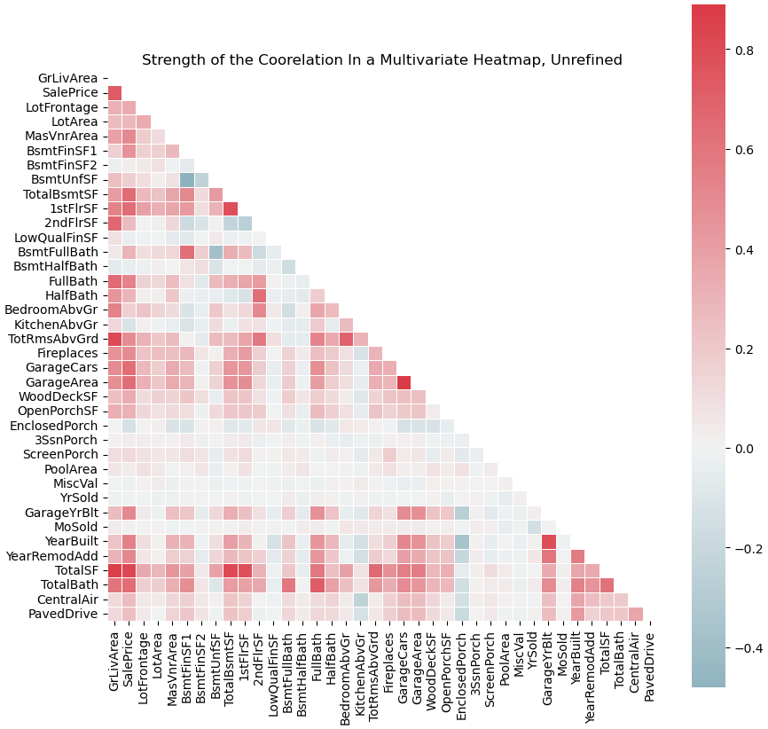
MLR: Summarizing Unrefined Results
To the left, we see the correlations of what the previous MLR told us. Here, it only tells us the numeric correlations, which is why the most significant result, Overall Quality, is not found.
From the heat map, we can see that Total Square Footage is not only very statistically significant, it also is strongly correlated with Sale Price. TotalSF is a custom variable, made from combining all SF variables.
Another note here, Full Bath is highly correlated, yet the unrefined MLR said that it was one of the most insignificant variables, further hinting the data needs to be refined.
Notes:
Here shows the collinearity of what the MLR model told us, focusing only on the numeric results. We can see that just because something is highly correlated, doesn’t mean that it is statistically significant. For example, the model told us that Total Square Footage was significant, and here it is also the most highly correlated variable. But this also tells us full bath, which the model told us was near-1 in insignificance, actually has one of the stronger relationships. This is, say, in comparison to KitchenAbvGr, which is not correlated here, but was statistically significant in the model.

Slide 9

Random Forest: As a Model
A random forest model combines multiple decision trees into a single model. In this case, it would determine feature importance rather than MLR's significance and correlation. Feature importance is a degree of dependency on the variables being compared.
A decision tree is a hierarchical structure where each "node" represents branches based on different conditions being satisfied. Decision trees are subject to "overfitting", which can lead to "poor predictive performance".
(Image Created Via Stable Diffusion)
Notes:
A random forest model is used to find feature importance, or the degree of dependency of variables. It is the combination of multiple decision trees, the hierarchical structures that use nodes to test attributes. Overfitting is when the test error no longer nears the training error as the model complexity increases.

Slide 10
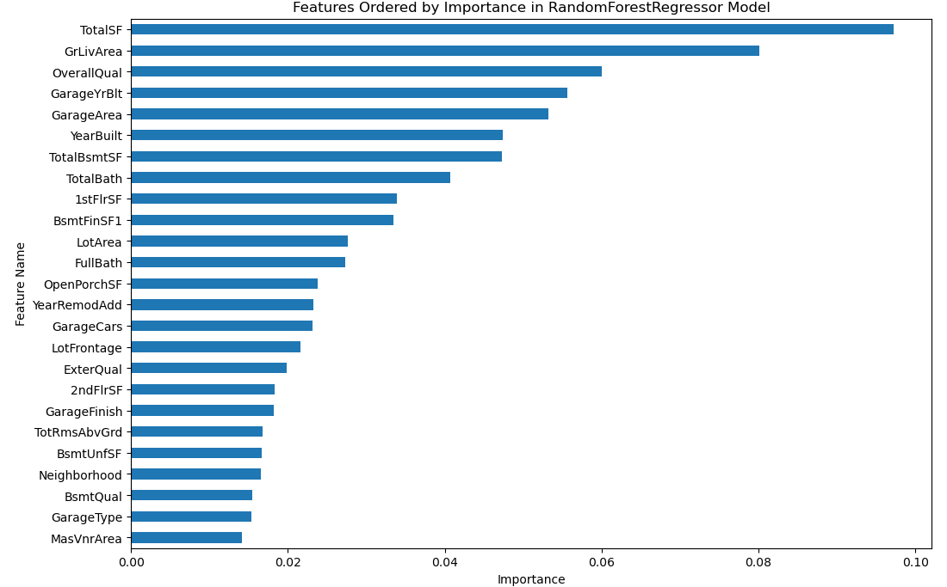
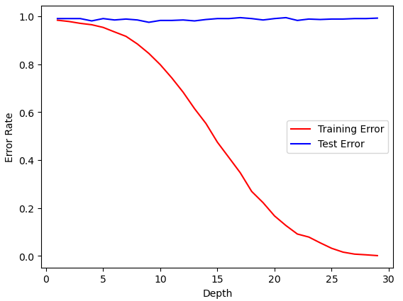
RF: Unrefined
The unrefined RF shows a vague similarity to the unrefined MLR, with OverallQual having high importance, as well as TotalSF having the highest importance.
However, the decision tree tells us that this graph is overfitting almost immediately. With a score that varies from .67-.87 based on one or two features, this model’s predictability is questionable at best.
Notes:
The random forest gives somewhat similar results to the MLR model, with TotalSF, OverallQual, and YearBuilt all having high importance. However, the RF claims that ground living area has very high importance, along with GarageYrBlt. Note that the MLR model considered GarageYrBlt to be statistically insignificant. The decision tree is also highly overfitted, which means low predictive accuracy, and therefore the model needs to be adjusted. The score also varied from .67-.87 based on the removal/addition of “summarized” features, which will be discussed later.

Slide 11

Constructing a Refined Model
In order to refine the models, we have to take what was discovered from feature importance, as well as statistical significance from the MLR model, and combine the results. This would hopefully create a smaller, more accurate model.
For example, from both models we know OverallQual is probably important, as are variables like YearBuilt, GrLivArea, FirePlaces, LotArea, etc..
We also know that several variables can be removed by default. TotalSF, as mentioned, combines three other variables. TotalBath combines four other variables, and MixedExterior combines two other variables, all of which are mentioned as being important. This gets rid of issues where the “parts” were considered insignificant, but the whole was not.
(Image Created Via Stable Diffusion)
Notes:
We know that the MLR suffered from multi-collinearity, which means too many features. We also saw several inconsistencies between the models, whether it be in importance, correlation, or significance. However, the models did tell us, in some ways, a few variables that stuck out in regards to significance and importance. For example, OverallQual is probably importance. We also summarized certain variables, like TotalSF which was consistently rated as most important, and can therefore remove the variables that it consists of.

Slide 12
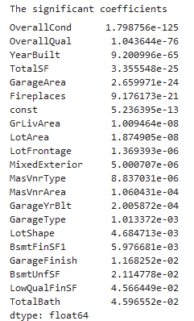
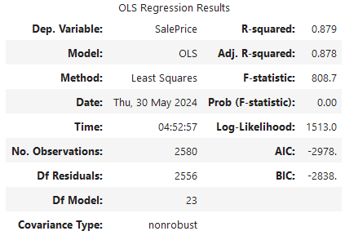
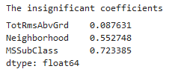
MLR: Refined
After refining the data, the MLR resulted in a lower score, but a higher F-statistic. This means it has a stronger correlation, but it is less predictable. We can also see that the results much more align with the importance scale, just based on eyeing it.
Some of the results are also identical to the unrefined MLR model, such as with the top two significant coefficients.
Notes:
Now in the refined model, we have a stronger ratio of significant features, and only three insignificant features. However, it should also be noted that the R-Squared actually decreased slightly, therefore decreasing its predictive reliability. YearBuilt is now more significant than TotalSF, but GarageArea, which was a feature important variable, is now very significant. SaleCondition wasn’t even in the top 25 in the unrefined RF model.

Slide 13
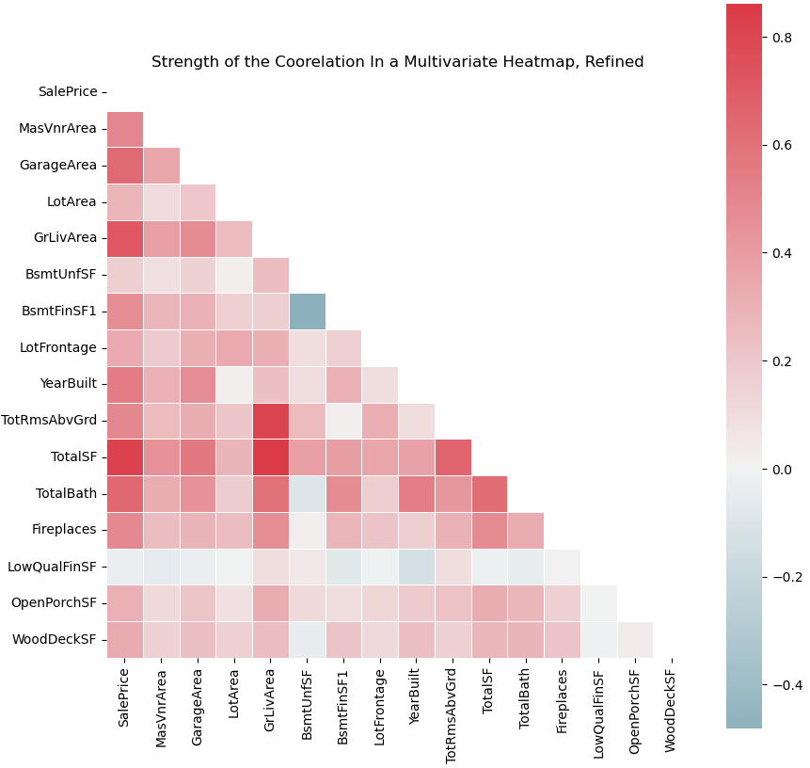
MLR Refined Correlation Summary
Here, we can see our results compared to the unrefined findings. The improved F-statistic told us there was a stronger correlation, and here we can see nearly every variable is “strong”, even against each other.
TotalSF, like with the unrefined model, is still clearly the strongest variable across the board.
What’s interesting to note is that LowQualFinSF seems to be the weakest of the correlations, yet even the refined MLR model didn’t consider it statistically insignificant.
Notes:
Here we can see just how much stronger the correlation is. Across the board, SalePrice has a strong correlation with almost every other variable excluding “low quality finished square feet”. Said variable was not considered statistically insignificant in the refined model, but was considered insignificant in the unrefined model. It should be noted this variable has only 33 non-zero values, which could not be turned into a viable plot for regression and can be distorting the data.

Slide 14
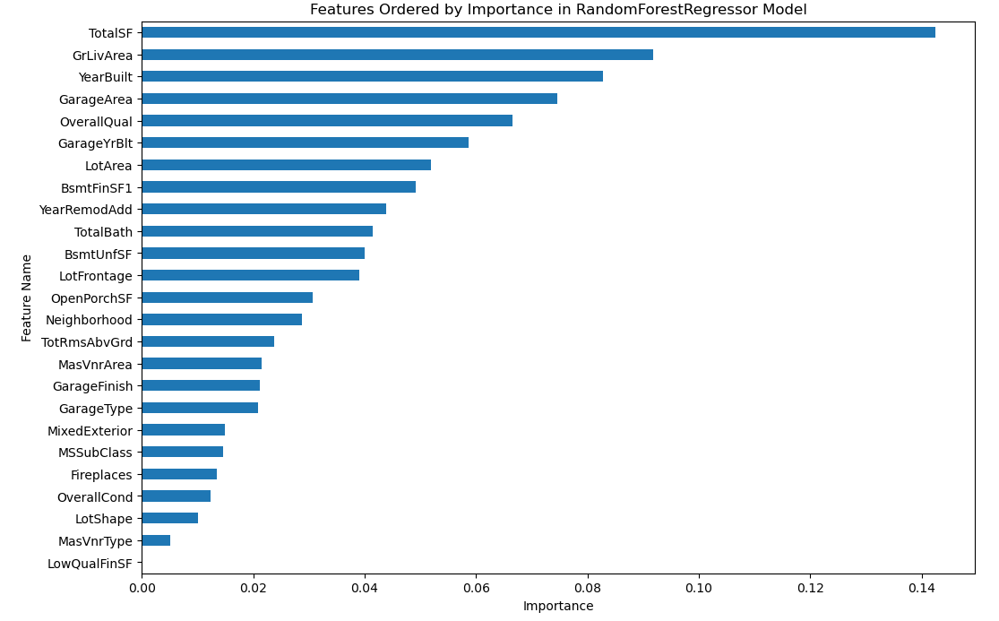
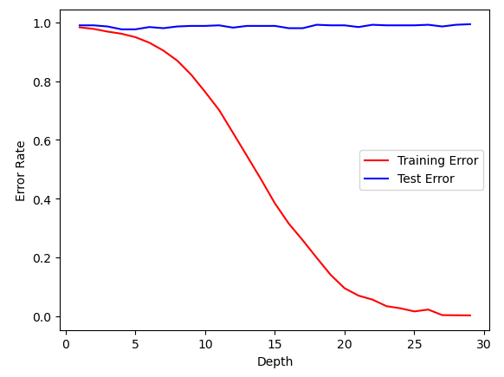
RF: Refined
The results here are more in-line with the correlations, with TotalSF still being the most important variable. Notably, LowQualFinSF also has zero importance here, which matches how it had very low correlation. However, this model still has a drastic overfitting issue.
Notes:
The refined random forest more in-line matches the correlations. YearBuilt and GarageArea now have higher importance, but the most notable aspect is that the overall importance has increased for all variables almost throughout. If the feature is important, it can be found “around” at the same level in significance, with a few exceptions like OverallCond and Neighboorhood, which was considered insignificant.

Slide 15
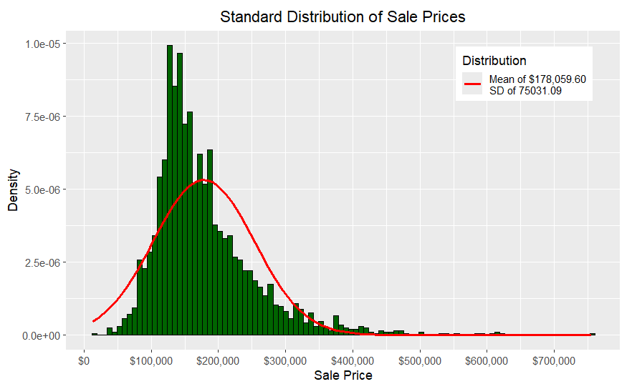
Breaking Down the Results: The Target
To start an analysis, we can look at the target of the models: the Sale Price. Using a standard distribution histogram, we can see that most houses have been sold at around $180,000. This is fairly typical, as most people cannot afford more expensive houses.
However, it should also be kept in mind that there are numerous outliers in the data because of this. In fact, one can even be seen here, with a house being sold at over $700,000. This means every variable, such as TotalSF, TotalBath, etc. would likely distort the data compared to what should be the average.
Notes:
Now that the models have been created, we can look at the actual analysis. For the target itself, Sale Price, when it comes to a standard distribution, we can see that most houses were sold at around $180,000. This makes sense since most people can’t afford expensive houses. We do notice outliers though. These outliers mean outliers for numerous other variables, like anything related to area and square footage, which can distort the data.

Slide 16
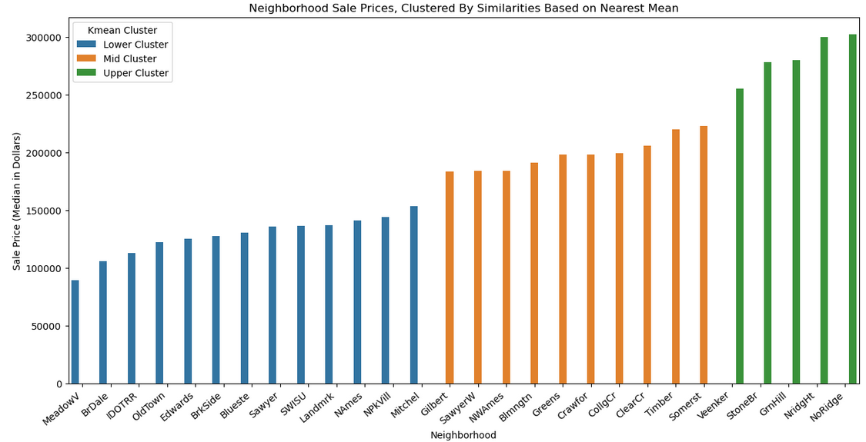
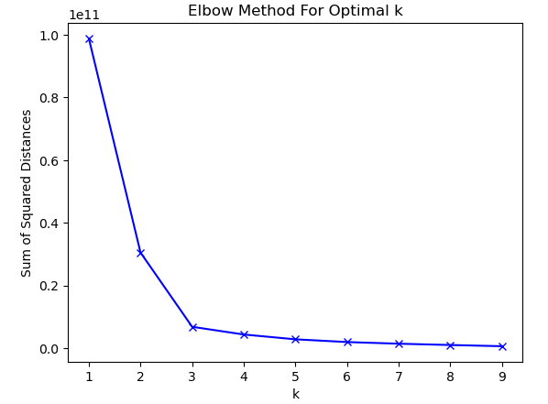
Binning the Neighborhoods
To get a better understanding of which neighborhoods produced the most significant sales, we decided to “bin” them using k-mean clustering. This is a grouping method where each value is grouped together based on similarities according to the nearest mean. To find said mean, one would use the “elbow method”, where the “elbow” is how many groups there are. So, here we can see there are three clusters of neighborhoods based on sale price, with the green cluster possibly being the most valuable.
Notes:
As for the neighborhoods, binning was used to find which neighborhoods had the most “expensive” houses. These were grouped according to similarities based on their mean, the k-mean. So, the most expensive neighborhood might be Northridge Village, while the cheapest might be Meadow Village.

Slide 17
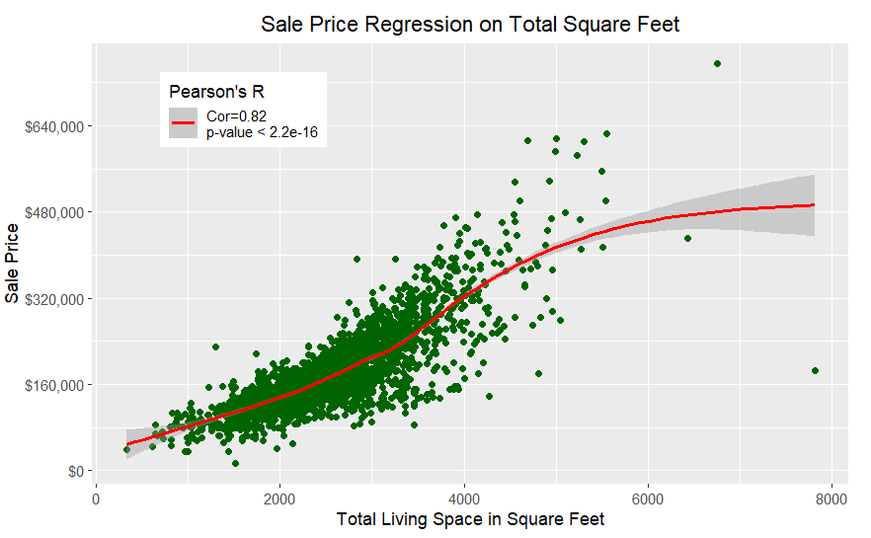
Most Important Feature: Numeric
According to our models, the most important numeric feature is TotalSF, which is the combination of the SF variables (TotalBsmtSF, 1stFlrSF, 2ndFlrSF). From a weighted regression model (loess), we can see it has a nearing-perfect positive correlation with Sale Price. This aligns with what both models said.
This has only two visible outliers, but they don’t distort the regression line enough to shift it in a meaningful way.
Notes:
The RF determined the most important feature was TotalSF, the combination of all square foot features, and the MLR model said this was also the most significant numeric feature. When running a weighted regression model, the models still stand, with it almost being a very strong correlation and having a near-linear positive regression.

Slide 18
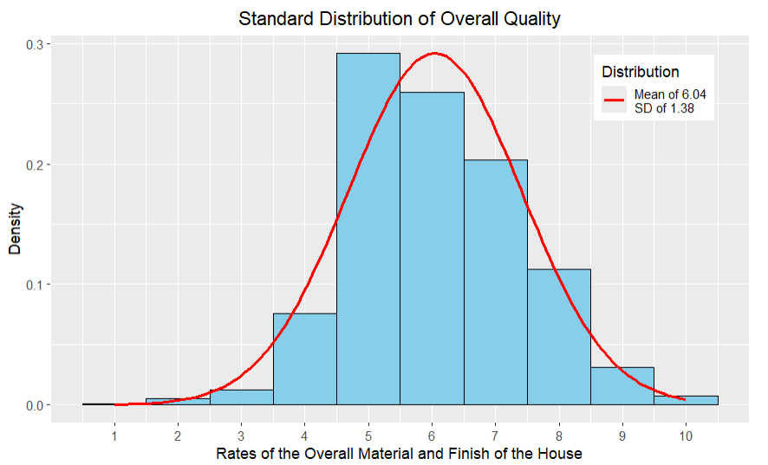
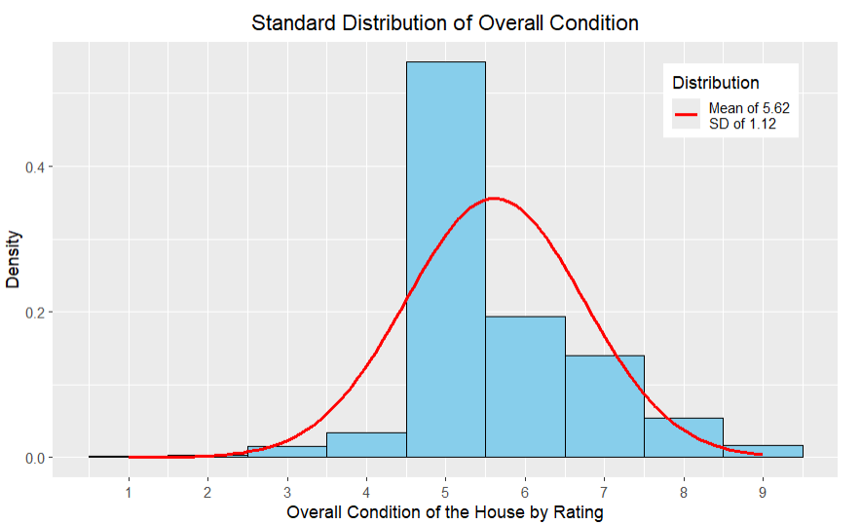
Most Important Feature: Categorical
Our models seem to at least agree that OverallQual is both important and significant, but the random forest model rates OverallCond lower in importance, while the MLR model rates it extremely high in significance. The meaning of this will be examined.
Right away, we can see smaller variation in the data. While less variability means less extreme data, this also looks like the regression is going to be more effected by weight.
Notes:
The refined random forest model claimed that overall condition was not very important, despite both MLR models claiming just how significant it was. Yet still, the random forest model said overall quality was the most important categorical feature. We can see here the possible issue when looking at the distribution, where there’s less distribution and variability in the overall condition compared to quality.

Slide 19
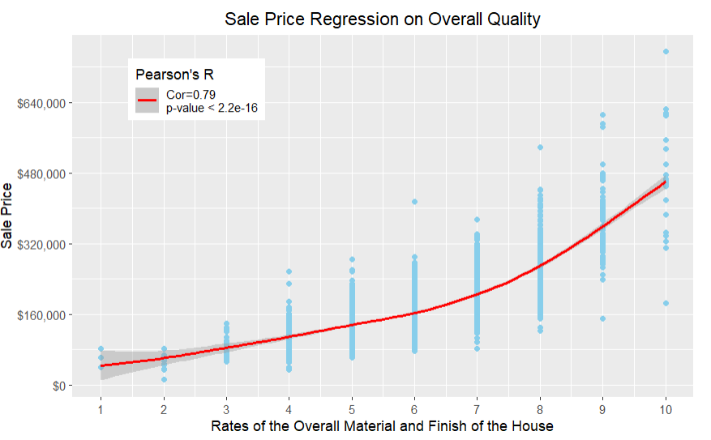
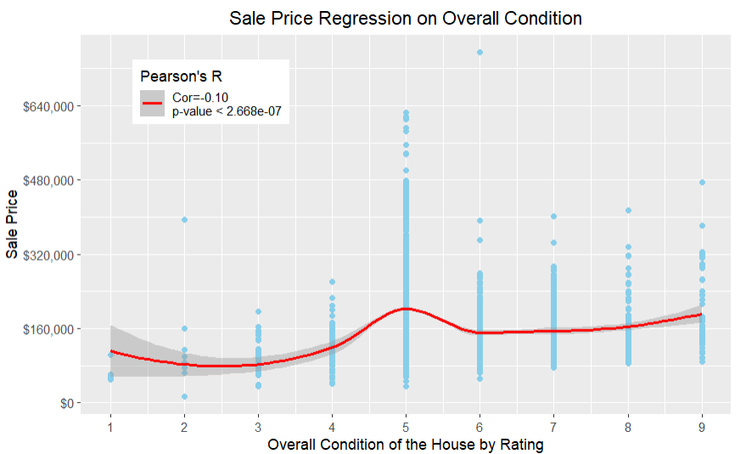
Weighted Regression on Housing Rates
As expected, the OverallQual variable has a much higher correlation than the OverallCond variable. So much so that OverallCond goes into the negative. This may explain why OverallQual is so much higher in the RF model. As shown in the previous graphs, the smaller variability in OverallCond caused so much focus on one rating (5) that the loess regression produced a “hump” at that point.
Notes:
This lack of variability is then shown here, how the focus on the mean of five led to an immensely weak correlation for overall condition, while overall quality has a much stronger correlation. We can also see that, when taken individually, the pearson’s R significance for condition is lower than quality.

Slide 20
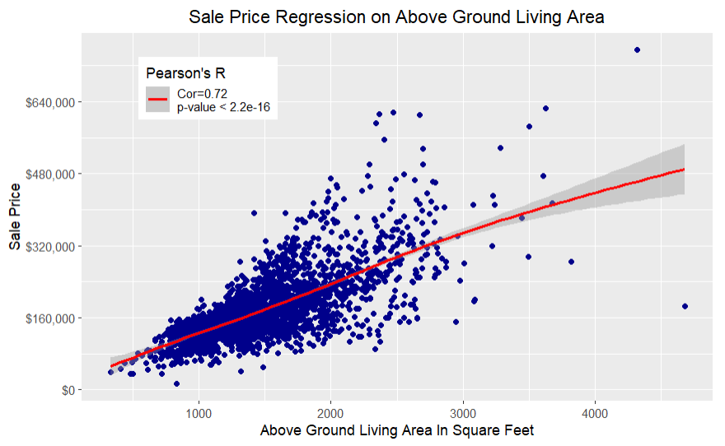
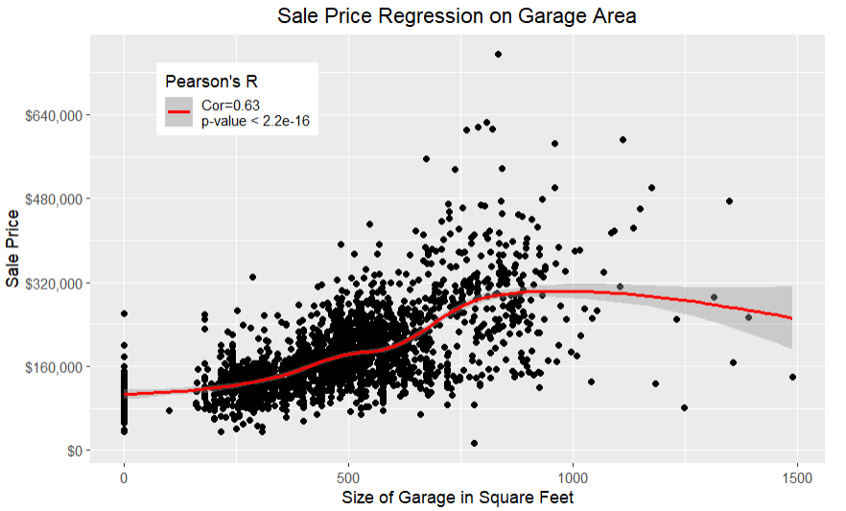
Other Highly “Important” Features
The other most important features, according to the RF model, are similar to the TotalSF. They are highly correlated, along with being statistically significant. GarageArea was actually considered one of the most significant factors, according to the MLR model, but here we see GrLivArea coinciding with linearity more. GarageArea also has a numerous amount of “0” values, presumably those houses that do not have garages, which could distort the data.
Notes:
Here are some of the higher highly significant and important features mentioned in the models. Their correlation strengths are both high, although as the strength decreases, the linearity seems to be affected as well, along with the weighted regression line.

Slide 21
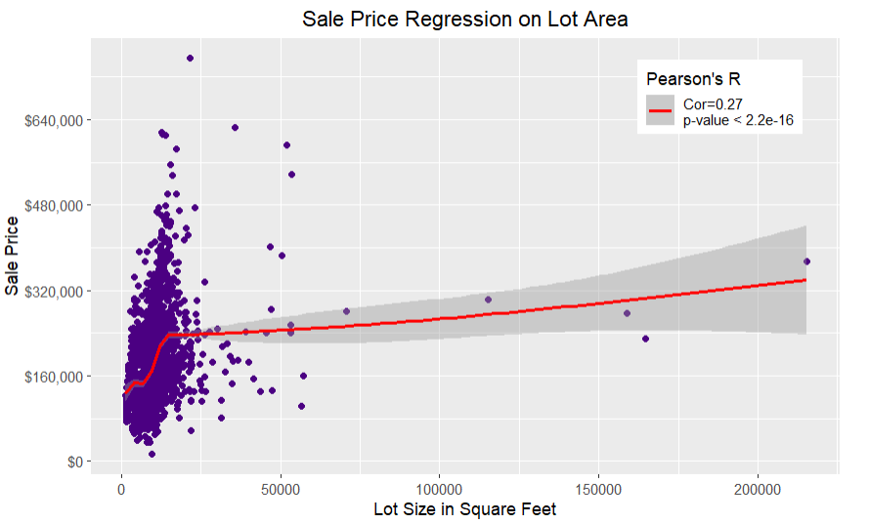
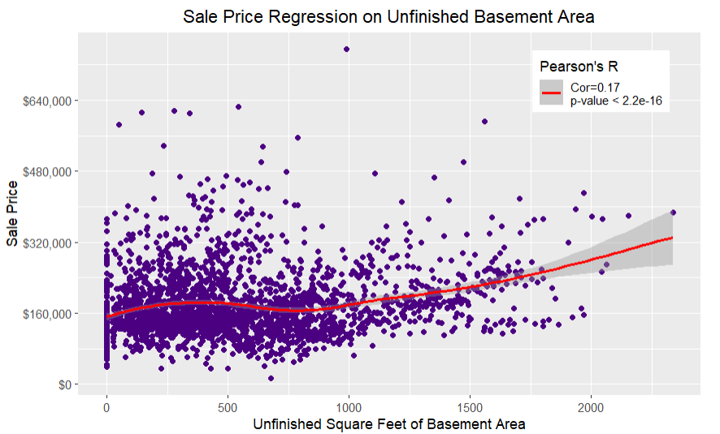
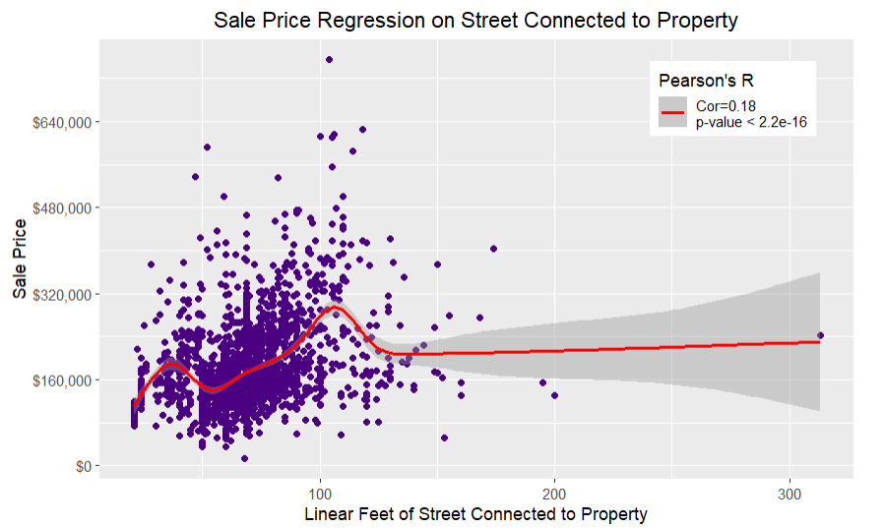
The Weaker Correlations
The RF model claimed LotArea, BsmtUnfSF, and LotFrontage all had “decent” importance. The MLR model claimed BsmtUnfSF had one of the lowest (as in not good) statistical significances. When actually tested, we see that the correlation for all, except for Lot Area, are particularly poor. Notably, the unrefined model considered LotFrontage and BsmtUnfSF unimportant, which contradicts the refined model.
Notes:
These three values, Lot Area, unfinished basement square footage, and lot frontage, as they seem to go against the refined model when actually analyzed. The strengths of their correlations are not strong, despite having an “okay” feature importance, and the unrefined model considered two of these values unimportant. Yet still, all variables remain significant. This shows a discrepancy between the models, and further hints at the issue of accuracy of them.

Slide 22
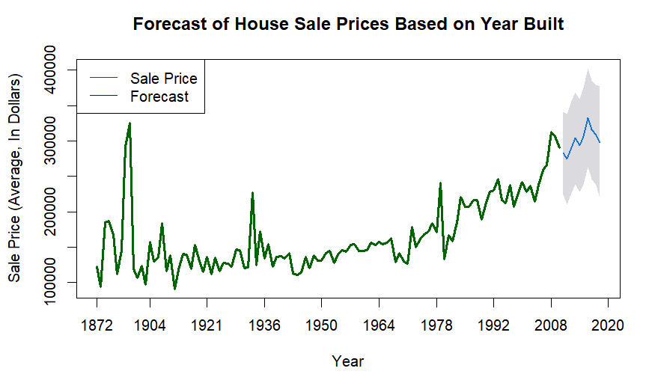
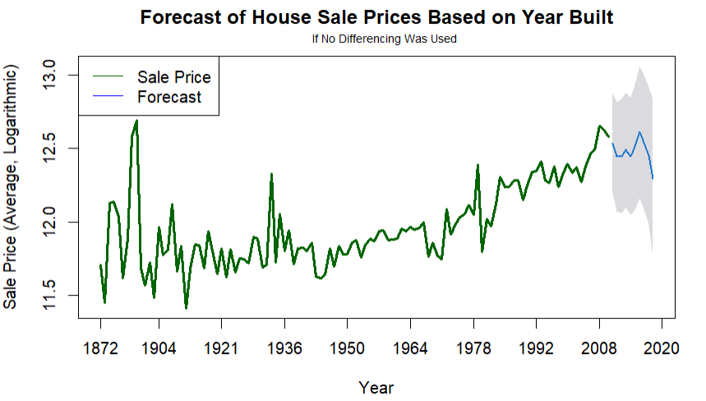
Time Series Model: Year Built
The models determined that one of the most significant and important features was YearBuilt. This is a special variable, as it is a date variable. To analyze this, a time series model would be used. Here, we can see a clear trend that SalePrice increased, with a drastic increase peaking at around 2006-2008.
Using an Arima Forecast, the model believes the trend will continue to rise, depending if the series is dependent on time (note that 2010 only had two data points, which caused the data to be non-stationary).
Notes:
Since YearBuilt was considered so important, a timeseries was created to better visualize a date value’s effect on the target. The sale price seems to undergo several spikes as it gradually increases. However, the most recent rise from the mid-2000’s housing bubble (leading to the crash in 2008), affects the forecast. If using differencing, the model assumes the trend will continue, without differencing (that is, assuming the data is now stationary), the forecast predicts a more gradual fall.

Slide 23
Summary: The Models
Overall, the models give us mixed results. The unrefined models have a higher score than the refined models, yet the refined models clearly deal with the unique problem of multi-collinearity. Notice how the RF refined score is substantially lower than the unrefined score, yet the included factors do explain importance much more than the unrefined model.
The refined models focus-in on the strength of the relationships, while still leaving room for similarity between the models (such as how TotalSF is the most important feature, and how OveralCond is the most significant feature in both models).
Yet still, there are many discrepancies to be made, such as how one of the lowest correlated numeric features, BsmtUnfSF, is the 11th highest feature of importance in the refined model, but the 4th lowest in the unrefined model.
The immediate overfitting is apparent for both the unrefined and refined RF models, and it should also be noted that the AIC is 500 points lower in the unrefined model. This is supposed to indicate a more optimized model, although the BIC is only around 100 points lower.
MLR Unrefined Score | MLR Refined Score | RF Unrefined Score | RF Refined Score
0.909 | 0.879 | 0.857 | 0.246
Notes:
The models give mixed results, where at multiple parts they are contradicting each other. The unrefined models have the issue of multi-collinearity, and consider some features important yet insignificant. The unrefined models highlight the strength of the relationships, while also still somewhat mirroring the unrefined models. Notably the scores for the unrefined models are lower for both, with the random forest score being abysmally lower. There are also many discrepancies, such as how the basement unfinished square footage is more important in the refined random forest model, and how the AIC is lower in the unrefined model.

Slide 24
Summary: The Data
The refined models can be used to pick out the features that have A) the strongest correlations and B) those that have the highest statistical significance. We can then test these features by themselves against the unrefined and refined models to see if the assumption still holds true.
It would appear that TotalSF in all cases has the strongest correlation. GrLivArea was considered the second most important feature, but its strength was outmatched by OverallQual, which was consistently one of the features with the highest statistical significance.
OverallCond notably had a very low correlation, even though it was one of the most statistically significant relationships according to the models. However, when tested alone in Pearson’s r (note the MLR were Ordinary Least Squares models) it was actually had a lower significance than the other relationships.
We noted that the weakest relationships were inconsistent when displayed in the unrefined and refined models, such as how certain ones were considered more/less important in the refined model, and vice versa. This was also reflected when tested alone.
The time series model was fairly typical, marking the build-up to the 2008 financial crisis. The forecast was divided between predicting an uptrend and a downtrend, depending on differencing because of such an “odd” event.
Notes:
When it comes to the data based on the models, as expected, the total square footage is the strongest, most significant feature. This was followed by above ground living area and the overall quality. Overall condition was considered extremely significant in the MLR model, but when actually examined the relationship was poor. As explained before, the weakest relationships were inconsistent in the unrefined and the refined models. The time series was also expected, with sale price increasing and the forecast behaving oddly in reaction to a shock.

Slide 25
Areas For Improvement
Feature Selection: We refined the results arbitrarily based on the feature importance combined with the statistical significance. Judging by what was mentioned with “best score”, the slightest changes with what was selected could have drastically affected the results.
Effects Size: One of the notable problems with the models was that the correlations went against the significance. A feature can be statistically significant, but not statistically meaningful. A model should, ideally, reflect both.
Outliers and Missing Values: Most of the missing values were replaced with “mean”, unless context said otherwise. This is not always wise and can distort the data. Furthermore, no outliers were removed. This can severely effect linearity when it comes to a probability plot. This is noticible in several of the graphs.
Other Models: Other models can be used to address various issues. This includes gradient boosting, lasso regression, gridsearch, and feature engineering.
Modeling
Data
1
Predictive Reliability: The score for all models was lower than desired. Ideally, they should all be above .90
1
2
2
3
3
Normalization: Data can be normalized to reduce problems with overfitting.
Notes:
There are many areas that can be improved. In regards to the models themselves, the predictive reliability was low, especially after being refined. This can be increased using various methods related to other areas for improvement, such as a lasso regression for feature selection. Another problem frequently brought up is how the models were inconsistent. A feature can be statistically significant, but not statistically meaningful. A model should reflect both, and the requirement of swapping back and forth is not ideal. Obviously other models can be used, such as gridsearching and gradient boosting.
In regards to the data, feature selection can be adjusted, which previously had a notable change on the outcome to begin with. We could also change how we deal with outliers and missing values, where it was pointed out just how much outliers could affect the weighted regressions. All numeric data can also be normalized, which potentially allows for better, faster, and more accurate results.

Slide 26
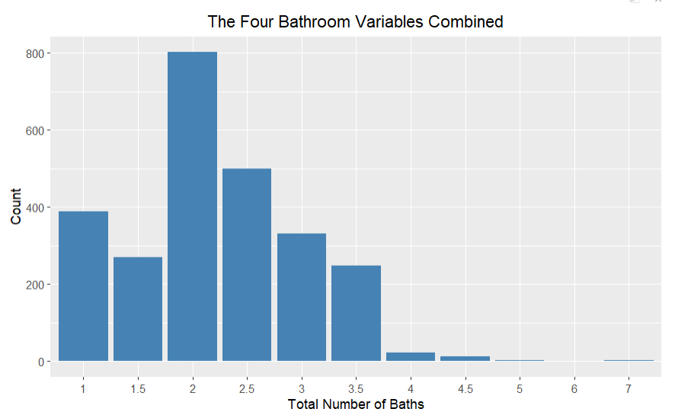
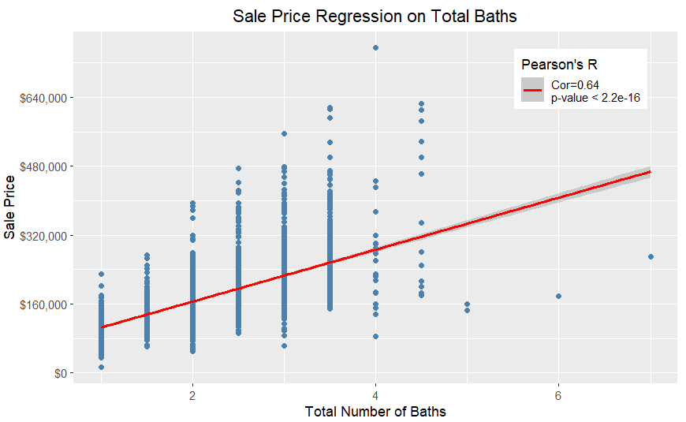
Questions? Comments? Suggestions?
(This is just a random graph to further demonstrate discrepancies, as TotalBath has a higher correlation and significance here than OverallCond)
Notes:
These final graphs just shows another discrepancy. TotalBath has a higher correlation and significance than condition, yet was ranked lower in both importance and significance in both models.

